Slide 1
Milestone #1 Group#2

Slide 2
Agenda
Discuss the complete scope of the project
Set out the flow for Group 2 Capstone Project
Discuss the First Milestone

Slide 3
Scope:
Milestone #1: | Importance of Big Data Security Big Data Security Technologies
Milestone #2: Milestone #3: Milestone #4: | Big Data Security Risk Big Data Security Use Cases Big Data Security Issues

Slide 4
Scope:
Milestone #5: | Regulation and Policy
Milestone #6: | Implementation Part 1
Milestone #7: Milestone #8: | Implementation Part 2 Implementation Part 3

Slide 5
Importance of Big Data Security
Prevents Data Breaches
Prevents Financial Loss to the Company
Safeguards Company’s Reputation
Maintains integrity and accuracy of data
Safeguards customers’ privacy
Notes:
Notes:
Security of Big Data is even more important than its actual implementation.
Making Big Data secure can have the following benefits to the company:
It prevents data breaches which can result in data theft and can lead to further cyber attacks to other companies and customers.
It also helps in preventing financial loss from legal actions and federal fines.
It also helps in safeguarding the company’s reputation. As we all know, having a data breach can result in massive reputation damage which may result in loss of customers and contracts and can even lead to the company’s downfall.
Big data security also ensures that no unauthorized person or hacker tampers with the data which can result in the data giving inaccurate results.
Most importantly, Big Data is generated from general public, and often contains Personally Identifiable Information. If this data is leaked, it can result in identity theft and other privacy problems to the customers.
References :
None

Slide 6
Importance of Big Data Security
Ensures tamper-proof nature of data to avoid manipulated results.
PII needs to safeguarded since data is sourced publicly.
Notes:
Notes:
Security of Big Data is even more important than its actual implementation.
Making Big Data secure can have the following benefits to the company:
It prevents data breaches which can result in data theft and can lead to further cyber attacks to other companies and customers.
It also helps in preventing financial loss from legal actions and federal fines.
It also helps in safeguarding the company’s reputation. As we all know, having a data breach can result in massive reputation damage which may result in loss of customers and contracts and can even lead to the company’s downfall.
Big data security also ensures that no unauthorized person or hacker tampers with the data which can result in the data giving inaccurate results.
Most importantly, Big Data is generated from general public, and often contains Personally Identifiable Information. If this data is leaked, it can result in identity theft and other privacy problems to the customers.
References :
None

Slide 7
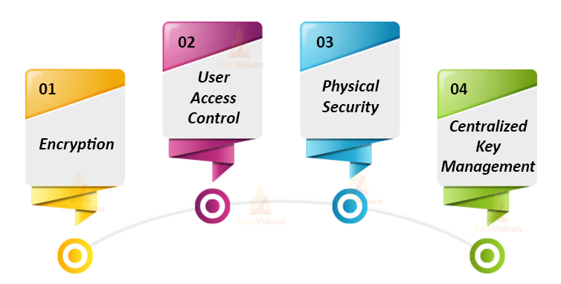
Big Data Security Technologies
Encryption – Tools like TDE to protect confidentiality
UAC – Prevent unauthorized access.
Physical Security – Protect integrity and availability.
CKM – Streamline access tokens that can be revoked centrally.
https://techvidvan.com/tutorials/big-data-security/
Notes:
Notes:
References:
Team, T. (2020, September 20). Big Data Security – Implementation, Use cases and Issues. TechVidvan. https://techvidvan.com/tutorials/big-data-security/

Slide 8

Big Data Security Technologies
Encryption
Need to secure massive amount of data
Can be applied to RDBMS or HDFS
Different analytic toolsets used to format the data
https://www.vexels.com/png-svg/preview/131264/lock-circle-icon-3
Notes:
Notes: Strong encryption helps to prevent data theft even in case of a breach. It is important to protect data at rest from malicious actors. Multiple tools can be used for encryption for hdfs and rdbms. HDFS provides end-to-end encryption. Data at rest is encrypted using TDE. Transparent Data encryption.
References:
Team, T. (2020, September 20). Big Data Security – Implementation, Use cases and Issues. TechVidvan. https://techvidvan.com/tutorials/big-data-security/

Slide 9

Big Data Security Technologies
b) User Access Control
Most basic tool with utmost importance
Automated UAC needed
Protects big data from inside attack
https://www.stickpng.com/img/icons-logos-emojis/users/simple-user-icon
Notes:
Notes: HDFS provides support for POSIX ACL to augment file permissions for users and groups. This ensures that only specific users can access specific parts of the data. References :
Team, T. (2020, September 20). Big Data Security – Implementation, Use cases and Issues. TechVidvan. https://techvidvan.com/tutorials/big-data-security/

Slide 10
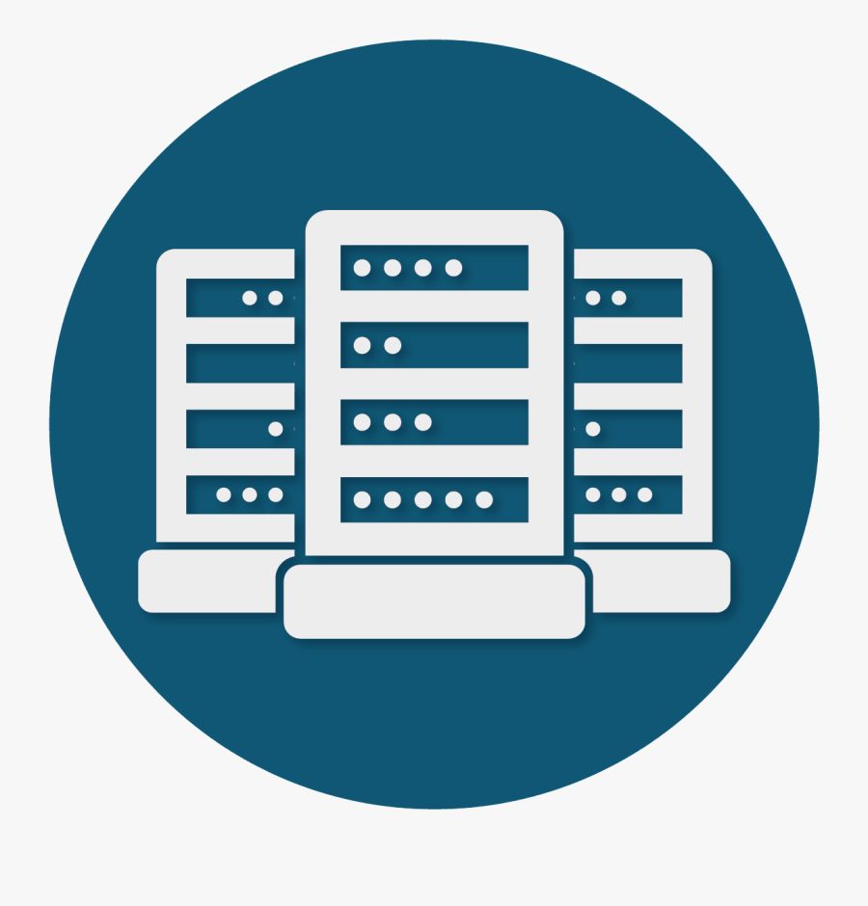
Big Data Security Technologies
c) Physical Security
Refers to security around data center.
Also Cloud provider’s security.
Video surveillance and security logs.
https://www.clipartkey.com/view/iiRmohw_logic-plus-icon-data-centre-data-centre-data/
Notes:
Notes:
No matter how strong your System Security is, if the physical site is not protected properly, someone might still be able to breach the security. Physical security needs to be maintained using perimeter and entry control devices such as RFID. It must be made sure only people with clearance access the facility.
References:
Team, T. (2020, September 20). Big Data Security – Implementation, Use cases and Issues. TechVidvan. https://techvidvan.com/tutorials/big-data-security/

Slide 11

Big Data Security Technologies
d) Centralized Key Management
Needed for wide geographical distribution environments
A single point for recovery
Policy-driven, logging and abstracting
System-wide key revocation
Similar to IBM, Cloudwick’s management should be the goal.
http://www.pngall.com/keys-png/download/58238
Notes:
Notes: Centralized Key management helps for system wide recovery. Accomplished using KMS or key management server. Supports over SSL.
References:
Team, T. (2020, September 20). Big Data Security – Implementation, Use cases and Issues. TechVidvan. https://techvidvan.com/tutorials/big-data-security/

Slide 12
Summary
Discussed the scope.
Talked about milestones.
Milestone #1 discussed in detail.
Big data security use case discussed and explained.

Slide 13
Conclusion
At milestone #1, we have understood the importance of Big data security.
We have understood the importance of protecting CIA by using tools like encryption, UAC etc.
Understood the technologies available for protecting Big data from unauthorized and malicious access. These technologies will be implemented during the 3 – phased implementation.

